Slide 1




MATLAB Fundamental Laboratory Handbook (MATLAB)
Chapter 7 Inputs and outputs
Dr Leo Chen
leo.chen@ieee.org
1

Slide 2
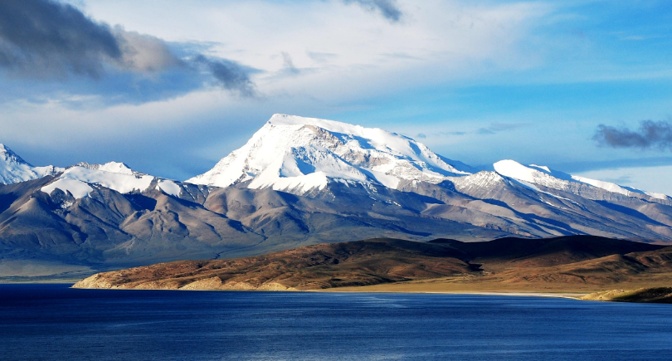

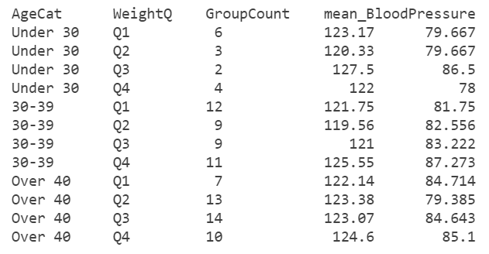

Various Datatypes
Image
Signal
Text
Numeric

Slide 3
7. 1 Lab
Objective: Input a spreadsheet
Content：
In a healthy examination, the blood pressure data is stored in an excel file bloodpressure.xls. Please read the blood pressure data from the file.
Open the file outside MATLAB and view the data.
% input the booldpressure data from a excel file
bpress = readtable("bloodpressure.xls")
% Open the file outside MATLAB for comparison
winopen bloodpressure.xls

Slide 4
7. 2 Lab
Objective: Input a text file
Content：
In the healthy examination, the data of weight and height are stored in a text file, weightheight_q.txt, please read from the file.
Open the file outside of MATLAB and view the data
% Input the weight and height data from a text file
wheightQ = readtable("weightheight_q.txt")
% Open the file in the editor for comparison
edit weightheight_q.txt

Slide 5
7. 3 Lab
Objective: Input a CSV file
Content：
In the healthy examination, part of the data is stored in a csv file, bodymeasures.csv. Please read it from the file.
% Read data from a csv file
body = readtable("bodymeasures.csv")

Slide 6
7. 4 Lab
Objective: Input a SAS XPORT file
Content：
In the healthy examination, part of the physical examination data is stored in an xport file. Please read it from this file.
% Read
demog = xptread("demographics.xpt")

Slide 7
7. 5 Lab
Objective: Output the data to a Mat file
Content：
Please output the data read in the above four experiments into a mat file
Read the file and check whether the four data items can be read by reading the file
save("fourtables.mat","body","bpress","demog","wheightQ");
clear
load('fourtables.mat')

Slide 8
7. 6 Lab
Objective: Input an image file, and output the image after being processed
Content：
Read an image of a mountain, peak.jpg.
Enlarge the image by 2x
Output the enlarged image
I=imread('peak.jpg');
figure;
imshow(I);
J=imresize(I,2,'nearest');
figure;
imshow(J);
title('Enlarged image');
imwrite (J, 'LargerImg.jpg')

